Slide 1
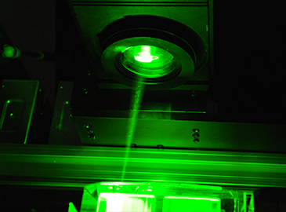
3-D Glass Laser Etching System
Group 20:
Monushka Sicar (Electrical Engineering)
Phillip Lane (Electrical Engineering)
Burdley Colas (Optics & Photonics)
Nicolas Ramirez (Computer Engineering)
Notes:
Monushka: I aint really feeling the look of this home page, need to make a theme(In general) and some edits
Title Page
Minimum requirements
Project title
Group #
Members
Administrative introduction (verbally?)

Slide 2
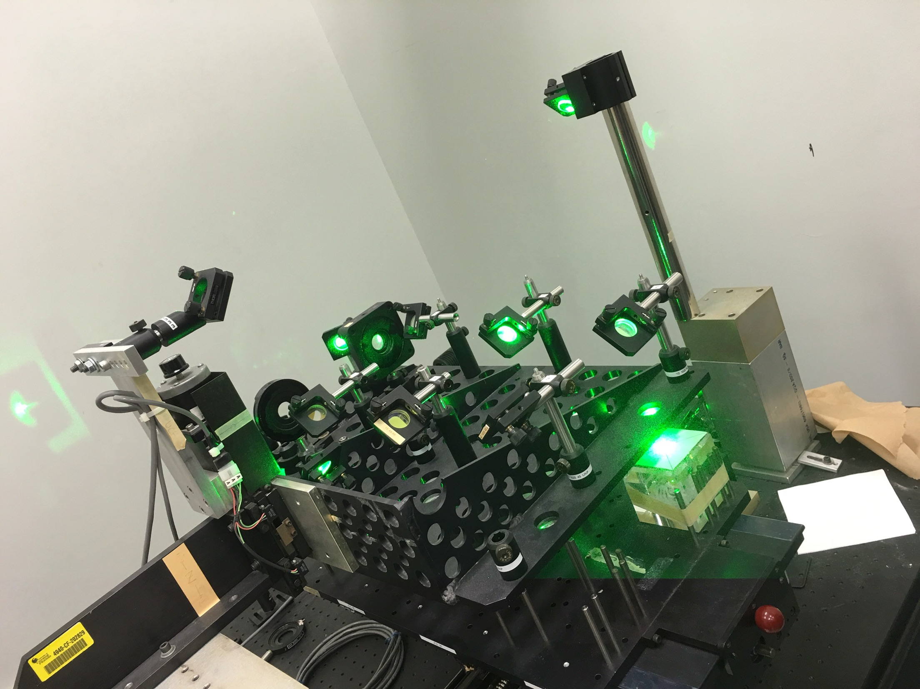
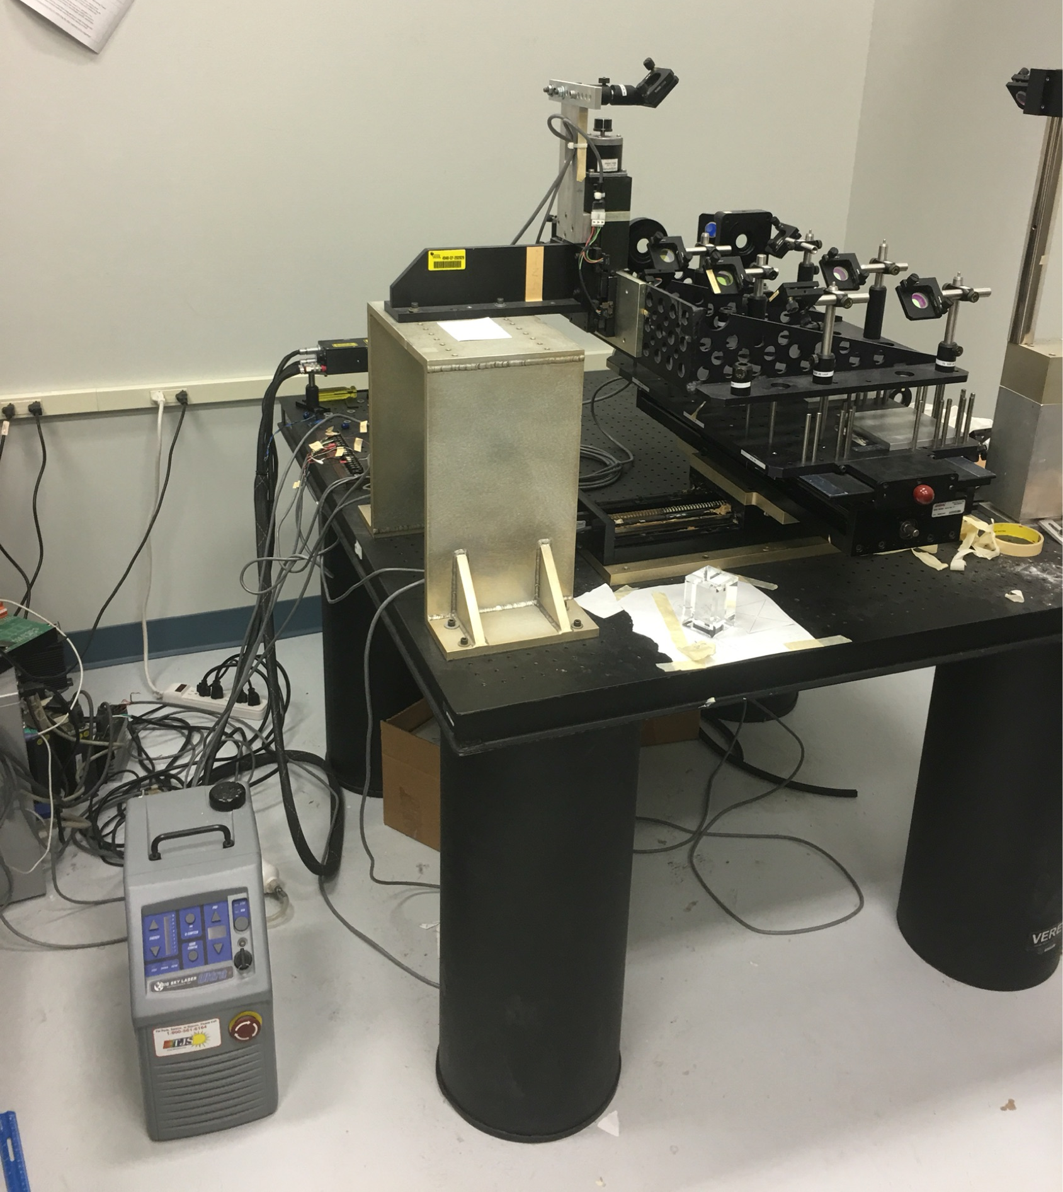
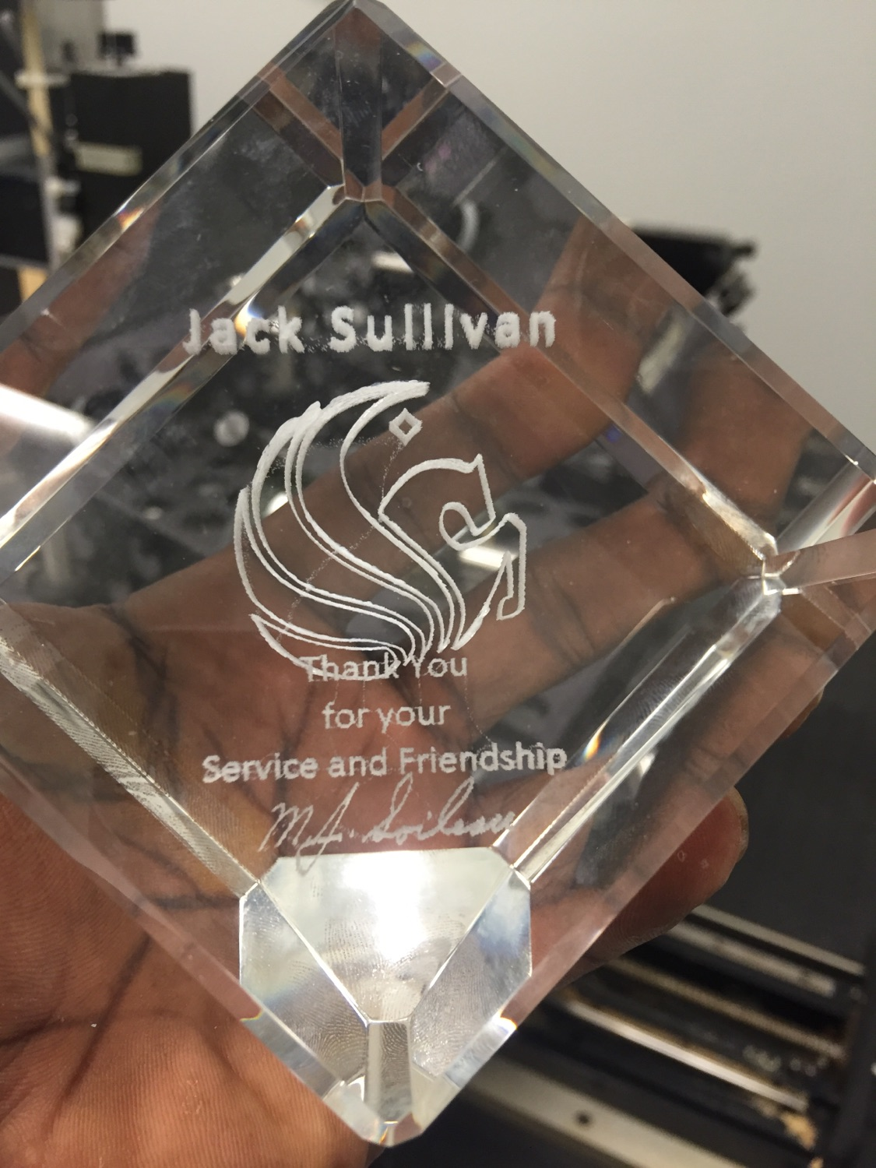
Motivation
Old Etching System:
Make 6 Awards at the same time
Not User friendly
Defect in image rendering
Hazardous (Electrical & Optical)
Long lead time
Bulky in size
Notes:
Current process is 6 hours
Computer was unsafe
General Needs
Identify uses of the project by customer
What is the project for?
Real World Needs
Transition to CREOL needs considering an existing system already existed
Include image of old system on right side, indicating its areas of improvements
Safety improvments
Speed
User friendliness
...

Slide 3
Goals and Objectives
Etch a single glass at once
Improvements user friendliness
Automate image formatting and processing
Eliminate need for machine pre-orientation
Higher safety standards
Integrate drivers as part of the machine
Protective optical shielding around machine
Notes:
Focus on improvements to be made
Explain how and why said improvements are important

Slide 4
Specifications and Requirements
Minimum glass size: 2.75 x 2.75 x 2.75 cubic inches
Max dimensions:
Total surface Area: 3 feet x 3 feet
Moving Parts: 2 feet x 2 feet surface area, 3 feet height
Move up to 20 lb. payload in vertical and horizontal direction
Use serial communications for real time control
Decrease etching time by 40% based on standard image (Pegasus logo)
Image Resolution 167 x 167 x 167 pixels for a 1 inch x 1 inch x 1 inch dimension (UCF Pegasus Logo)
Notes:
Put Specs in table format, color coding each discipline?
Specifications
Size
Optics Specs
Software Specs
Electronics Specs

Slide 5
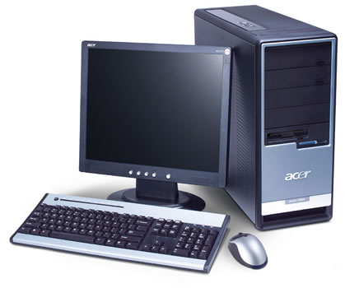
Overall System Diagram
Power
Comms and Control
Movement Mechanisms and Payload
Optics
Main Supply
U.S. Standard
(110-120 VAC)
AC/DC Adaptor
(12 VDC)
Regulator
(5VDC)
ATmega 328P MCU
Axis Limit Switches
Optics
Motor Driver Supply
(18 - 80 VDC)
Stepper Motor Drivers
FT232RL
USB-to-Serial
Laser
Stepper Motors
Optical Assembly
Z-Axis Mount
X and Y Surface Mount
Etching Glass
Notes:
High level block diagram that provides overview of how subsystems are interacting

Slide 6
Overall System Diagram
Power
Comms and Control
Movement Mechanisms and Payload
Optics
Main Supply
U.S. Standard
(110-120 VAC)
AC/DC Adaptor
(12 VDC)
Regulator
(5VDC)
ATmega 328P MCU
Axis Limit Switches
Optics
Motor Driver Supply
(18 - 80 VDC)
Stepper Motor Drivers
FT232RL
USB-to-Serial
Laser
Stepper Motors
Optical Assembly
Z-Axis Mount
X and Y Surface Mount
Etching Glass
Notes:
Monushka (Personal preference): Come back and find a way to change the colors of the arrows
High level block diagram that provides overview of how subsystems are interacting
Add animation to this slide to grey out everything except for POWER systems. We’ll first briefly go into how everything is powered.

Slide 7
Power
Constraint: using laser source from old machine
Various operating voltages
Laser Source: 115 VAC
Motor Drivers: 18-80 VDC
MCU: 5 VDC
 | DC Supply (Battery) | AC Supply
Erosion | High: If stayed in for too long can cause erosion | Low: No erosion occurs at power source
Circuit Damage | Low: Since it has power limitations are defined | Medium: Can occur during a power surge (Preventative measures: Surge protector)
Cost | High: Periodic Battery replacement | Low: No need to change Power supply

Slide 8
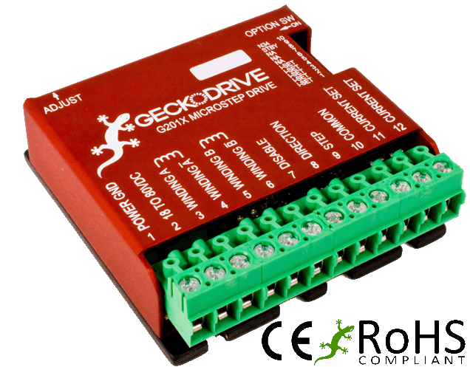
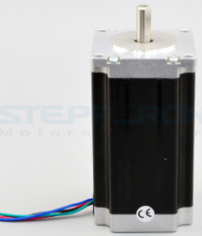
Power Consumption (Runtime)
G201X Digital Step Drive GeckoDrive
Voltage Rating: 18- 80 VDC
Power Rating: 1- 13 Watts
Nema 23-Bipolar StepperOnline (340 oz-in)
Voltage Rating: 24- 48 VDC ( Using 36 VDC)
Current Rating: 1.8 A/ phase
Notes:
If an etching operation actually lasted 1 hour 12 minutes (1.2 hours), the G201X Digital Driver would need to source up to (assuming 36 VDC operation) (13W)/(36VDC)*1.2hours =.4333 Ah. Although a current supply rating could be easily achieved, batteries to achieve a voltage of 36 VDC can become costly.
Include specific numbers

Slide 9
AC/DC Adapter
All of the electronics comprising the 3-D Laser Etching System, except the laser unit, motors, and motor drivers, are operated on direct current (DC) power
Power needs to converted to DC for the low voltage components ie. (Microcontroller), as well as provide a constant output voltage
Part Number | Input Voltage | Output Voltage | Max Output Current
120-1185 | 120 VAC | 24 VDC | 600mA
120-1165 | 120 VAC | 18 VDC | 600mA
TOL-09442 | 100 - 240 VAC | 12 VDC | 600mA
Notes:
All of the electronics comprising the 3-D Laser Etching System, except the laser unit, motors, and motor drivers, are operated on direct current (DC) power

Slide 10
Regulation
Regulator Type
Property | Linear | Switching
Efficiency | Low Vo/Vin | High, > 95%
Noise | Low | High, due to switching
Cost | Low | High
Supplies 5 VDC to MCU
Heat sinking a non-issue due to low current consumption
Efficiency a non-issue due to low current output
Notes:
**There is animation on this page !! *****
Overall, the cost and lack of design issues led to the decision of the standard lm 7805 Regulator.
The linear regulator efficiency may be negligible considering low amount of current is sourced from it.
This leads to insignificant heat dissipation. So no need to go as far as having switching regulators.
As input voltage increases
Efficiency decreases
More voltage/power wasted through heat

Slide 11
Voltage Regulator

Slide 12
Overall System Diagram
Power
Commands and control
Movement Mechanisms and Payload
Optics
Main Supply
U.S. Standard
(110-120 VAC)
AC/DC Adaptor
(12 VDC)
Regulator
(5VDC)
ATmega 328P MCU
Axis Limit Switches
Optics
Motor Driver Supply
(18 - 80 VDC)
Stepper Motor Drivers
FT232RL
USB-to-Serial
Laser
Stepper Motors
Optical Assembly
Z-Axis Mount
X and Y Surface Mount
Etching Glass
Notes:
High level block diagram that provides overview of how subsystems are interacting

Slide 13
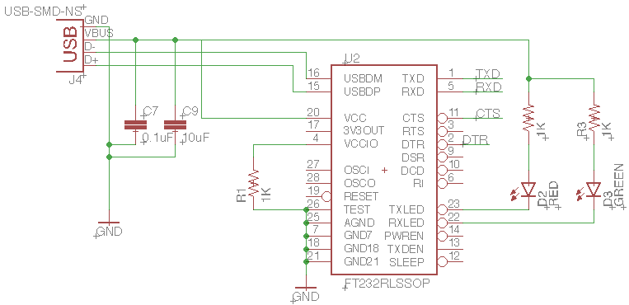
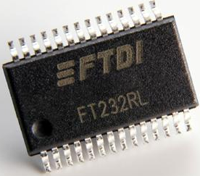
FT232 IC
Purpose
USB-to-Serial Conversion
Programming MCU
Gcode streaming
Notes:
This design
The old machine used RS-232 communication for:
Controlling laser
Controlling motor drivers (that then controlled motors)

Slide 14
MCU Selection
Selection Criteria
Serial communication
≥ 10 I/O Pins
Current consumption
Memory
Cost
Characteristic | Atmel ATmega 328P | Atmel ATmega 32U4
Operating Voltage | 1.8 - 5.5 V | 2.7 - 5.5 V
Serial Port (UART) | Yes, one port | Yes, one port
Flash Memory | 32 kB | 32 kB
Max I/O pins | 23 | 26
Max Frequency (5 V) | 20 MHz | 16 MHz
Operating Current (at max frequency) | ~ 12 mA | ~ 13 mA
Cost (USD) | 4.30 (TH) | 6.95 (SMD)
Notes:
ATmega 328P
It has 23 programmable I/O pins: only 12 are needed to send signals to the drivers.
Figure 33-2 of datasheet (complete) 12 ma suply current when active, operating on 20 MHz
ATmega 32U4
Figure 30-4 of datasheet (complete) 13 mA supply current when active, operating at 16 MHz

Slide 15
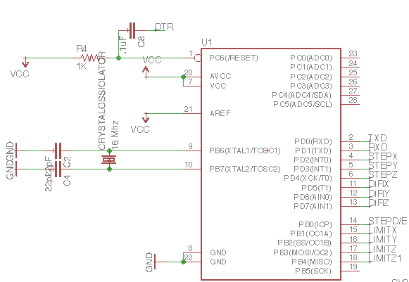
MCU Schematic
Notes:
Mention importance of RC timing combination for integrating MCU with FTDI circuit. Allows for uploading GRBL updates.

Slide 16
MCU Firmware
Critical System Needs
Concurrent control of 3 motors
Line (Bresenham), cornering, and arc algorithms
User friendly
Real-time start/stop
Steps/distance specification
Travel limit specifications
Open source
Homing and Localization
Notes:
Maybe add in high level block diagram of how grbl is working
Parses incoming/streaming gcode
Creates plan to execute the gcode instruction
Executes gcode instruction, while also waiting for the next instruction

Slide 17
Grbl High Level Diagram
Start
Homing
Buffer Full?
NO
YES
Wait for Command to Clear
Read Command
Parse Command
Command Cleared
Accept Command
Velocity & Acceleration Planner
GCode Buffer
Execute Command
Clear Command
Notes:
Grbl functioning
Perform homing upon startup
Start listening for gcode commands
Check if gcode command is valid
Execute gcode command

Slide 18
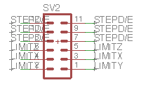
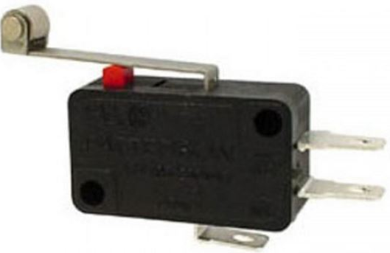
Axis Limit Switches
Purposes
Limit travel during etching process
Normally open configuration
Grbl homing feature
Notes:
Grbl homing feature avoids manually positioning the machine upon MCU startup

Slide 19
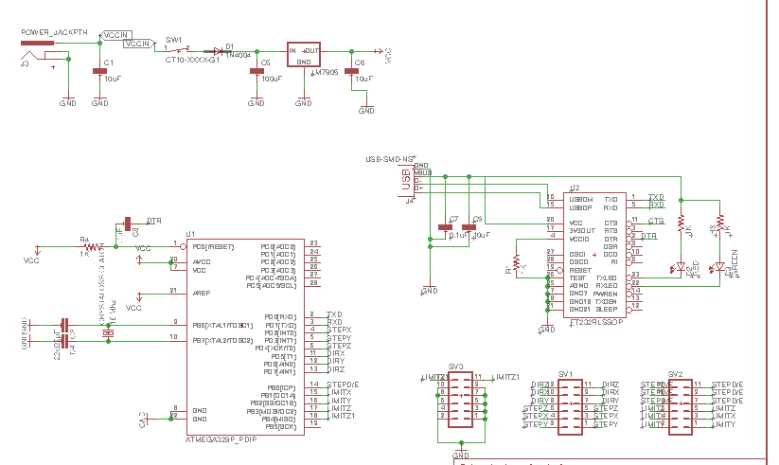
Overall Schematic

Slide 20
Overall System Diagram
Power
Movement Mechanisms and Payload
Comms and Control
Optics
Main Supply
U.S. Standard
(110-120 VAC)
AC/DC Adaptor
(12 VDC)
Regulator
(5VDC)
ATmega 328P MCU
Axis Limit Switches
Optics
Motor Driver Supply
(18 - 80 VDC)
Stepper Motor Drivers
FT232RL
USB-to-Serial
Laser
Stepper Motors
Optical Assembly
Z-Axis Mount
X and Y Surface Mount
Etching Glass
Notes:
Circle around computer

Slide 21
Software Design
Programming Language
Python 3
Extensive standard library
Easy to implement
Libraries
TkInter
pySerial
Operating System
Windows 10

Slide 22
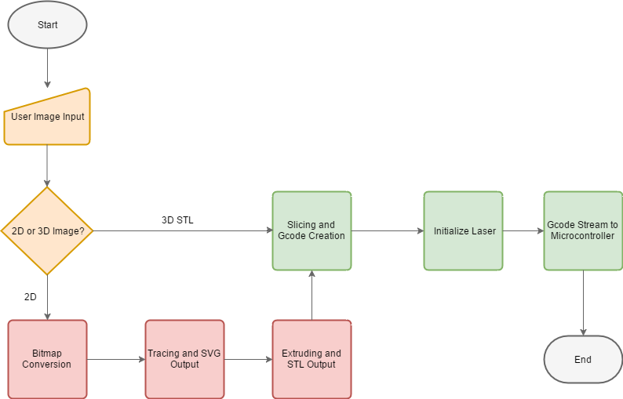
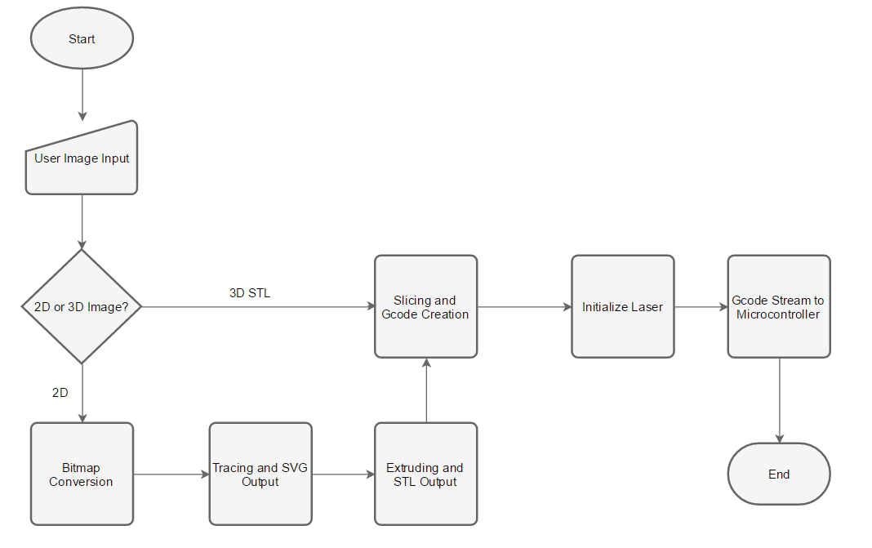
Simplified Flow
User Input
2D - 3D Conversion
Etching

Slide 23
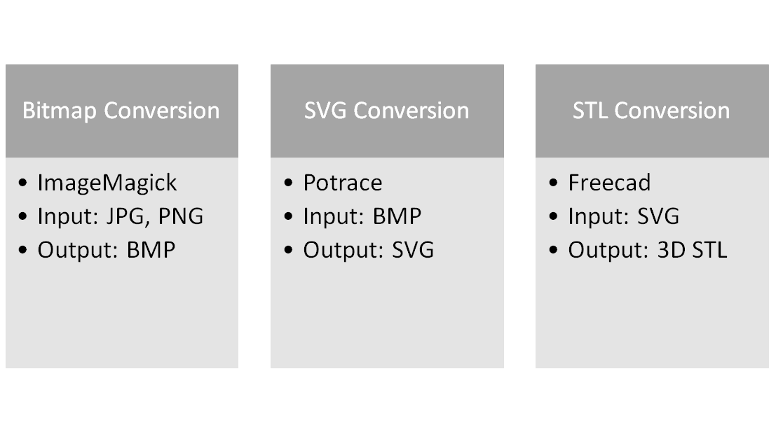
2D to 3D Conversion

Slide 24
Example Conversion
JPG/PNG File BMP SVG STL

Slide 25
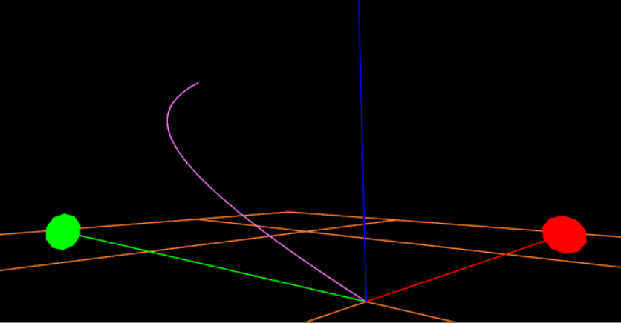
Slicer
Slicing
STL object is “cut” into slices
G-code file output
Slic3r
G-code
Numerical Control Language
Standard in CAM tools and machines
Movements
Where to, how fast, what path
Example G-code: G02 X5 Y10 Z5 R10

Slide 26
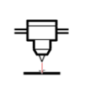
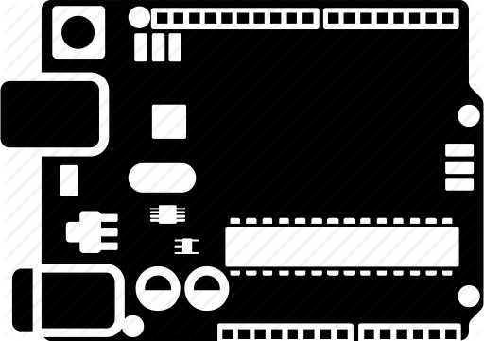
G-code Streaming
Python Script
Pyserial module
Python Standard Library
RS-232 Interface
Serial communications interface
Laser control before streaming
USB
Microcontroller communications
G-code transmission

Slide 27
User Interface
TkInter Module
Python Standard Library
Layer over Tcl/Tk Toolkit
Object Oriented
Major Focuses of UI
Automation
Simplicity
Unification

Slide 28
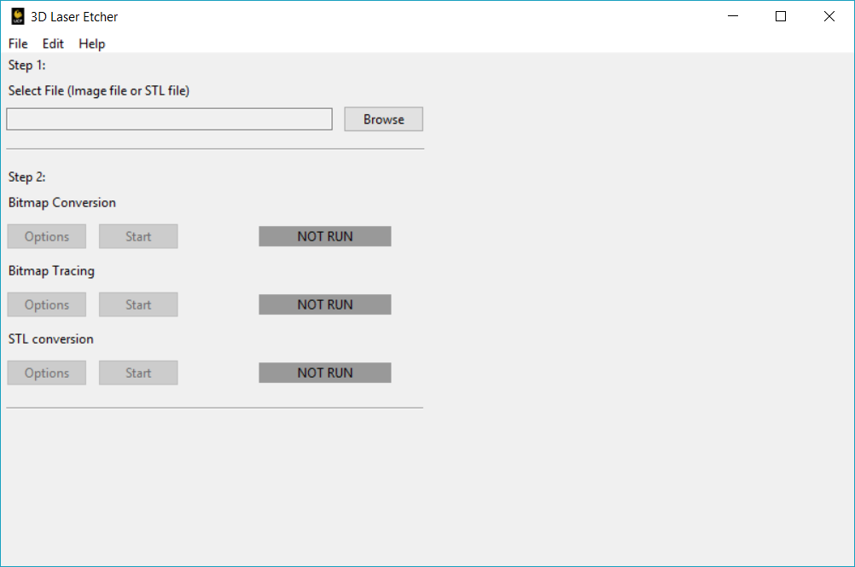
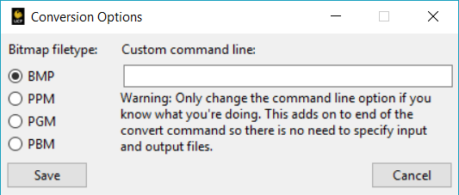
User Interface Design
Image Preview
STL Slicing and G-code Generation Area
Etching and Laser control Area
Notes:
Have screenshot of user interface and options and explain what is planned

Slide 29
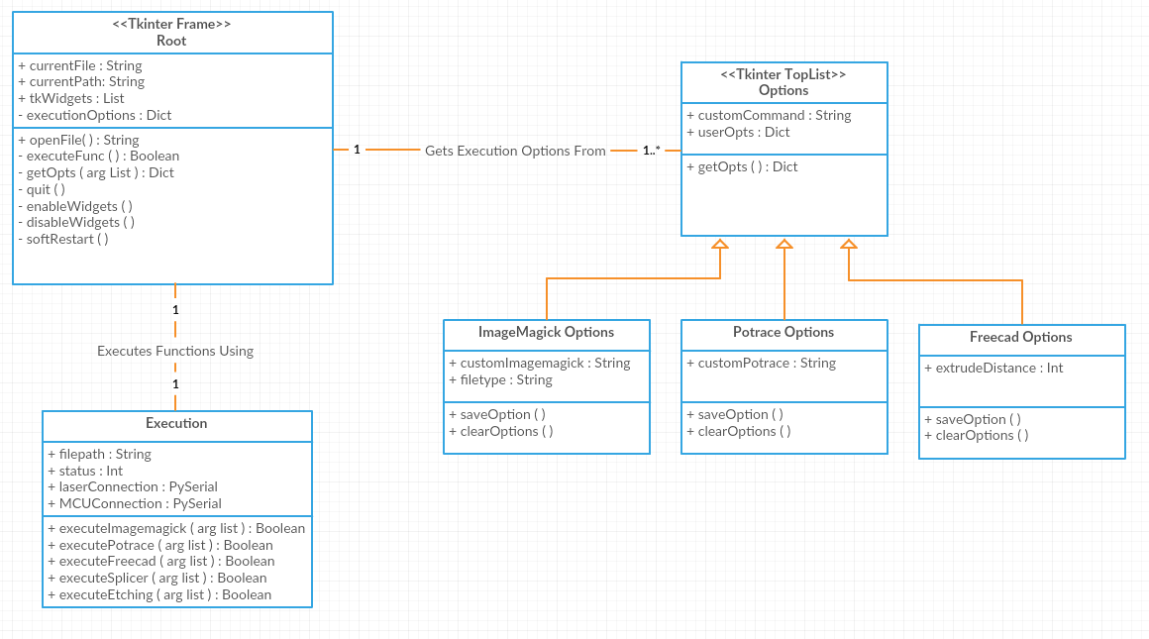
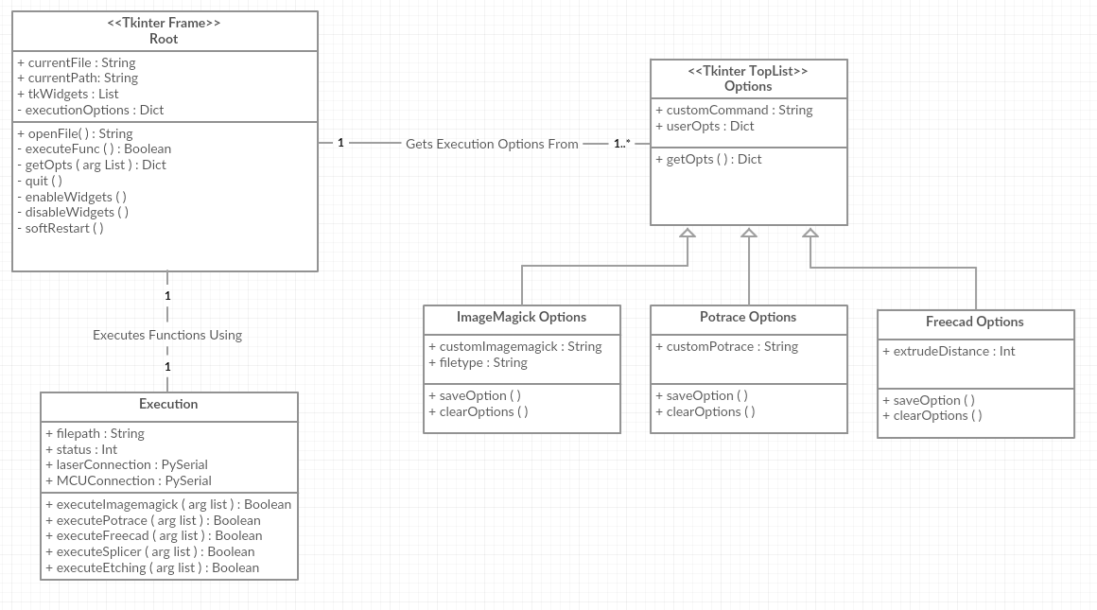
Class Diagram

Slide 30
Overall System Diagram
Power
Movement Mechanisms and Payload
Comms and Control
Optics
Main Supply
U.S. Standard
(110-120 VAC)
AC/DC Adaptor
(12 VDC)
Regulator
(5VDC)
ATmega 328P MCU
Axis Limit Switches
Optics
Motor Driver Supply
(18 - 80 VDC)
Stepper Motor Drivers
FT232RL
USB-to-Serial
Laser
Stepper Motors
Optical Assembly
Z-Axis Mount
X and Y Surface Mount
Etching Glass
Notes:
Developing the optical importance of the system.
Add animation to this slide to grey out everything except for POWER systems. We’ll first briefly go into how everything is powered.

Slide 31
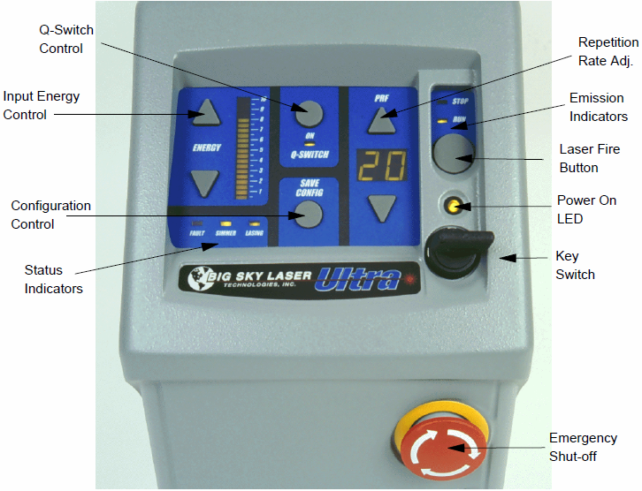
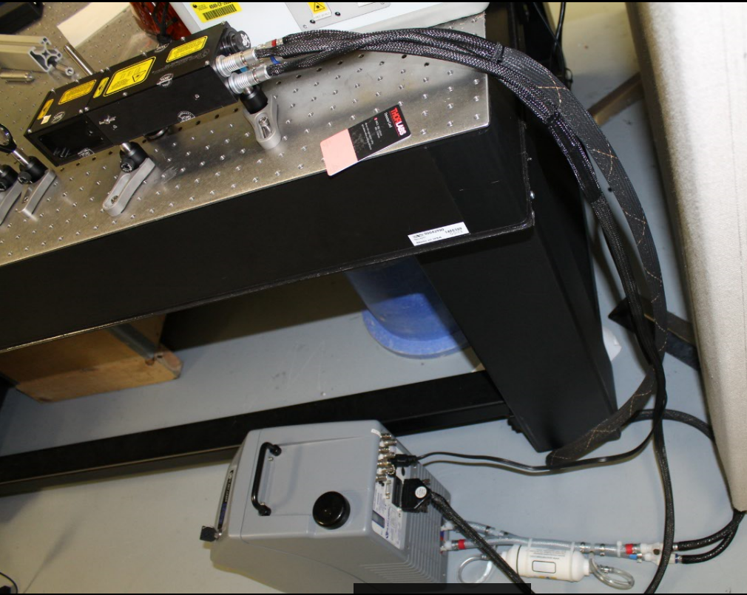
Laser:
Type: Nd-YAG
Wavelength: 532 nm
Energy : 30 mJ
Repetition Rate Frequency: 20 Hz
Pulse Width: 10 ns
Q-Switched
Pulsed
Water Cooled
Flashlamp Pumped
Laser Operation:
Turn Key
Adjust Desired Energy level
Adjust Repetition Rate Frequency
Push Q-Switch
Push Start

Slide 32
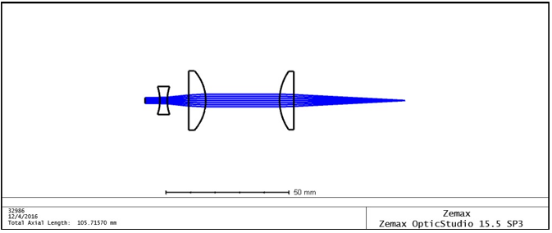
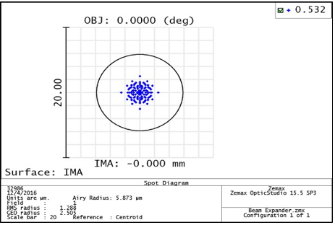
Beam Expansion and Subsequent Focusing Lens
Zemax Simmulation:
A telescoping beam expansion is implemented in the system to increase the diameter of the beam
A focusing lens is inserted to focus the beam to the desired beam spot to etch in the glass.
Lens Parameters and Spot Diagram :
Lens 1: focal length of -12 mm, and a diameter of 12 mm
Lens 2: focal length of 25.4 mm, and a diameter of 25.4 mm
Lens 3: focal length of 50 mm, and a diameter of 25 mm
Beam spot 3 microns diameter

Slide 33
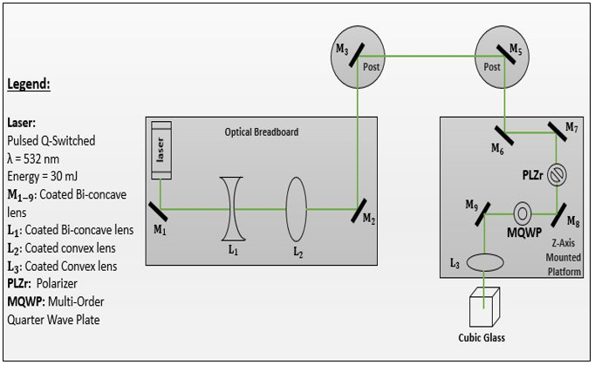
Optical System Design
PREVIOUS SYSTEM DESIGN:
This design intended to copy the old system design.
Using a two layer approach, the system has the z-axis which take the laser beam from above to etch the glass.
The advantages of the old system design helped us save on mechanical parts

Slide 34
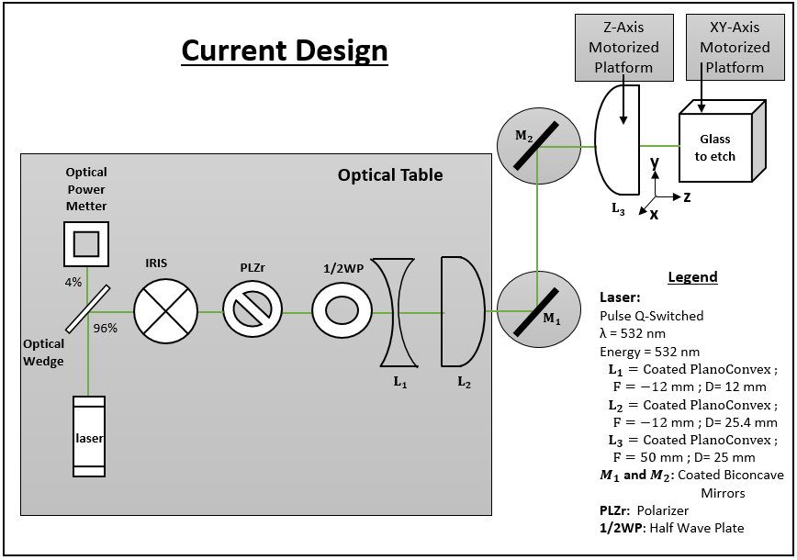
Optical System Design
CURRENT SYSTEM DESIGN:
Eliminates potential of extra mirrors due to axis change in beam optical path.
The Polarizer and Half Wave Plate are set in front of to the beam expansion and the focusing lens to help with beam clipping
The z-axis will now move the focusing lens, the xy-axis will move the glass
Safety : System will be surrounded by a Shield preventing hazard from reflected laser beam.

Slide 35
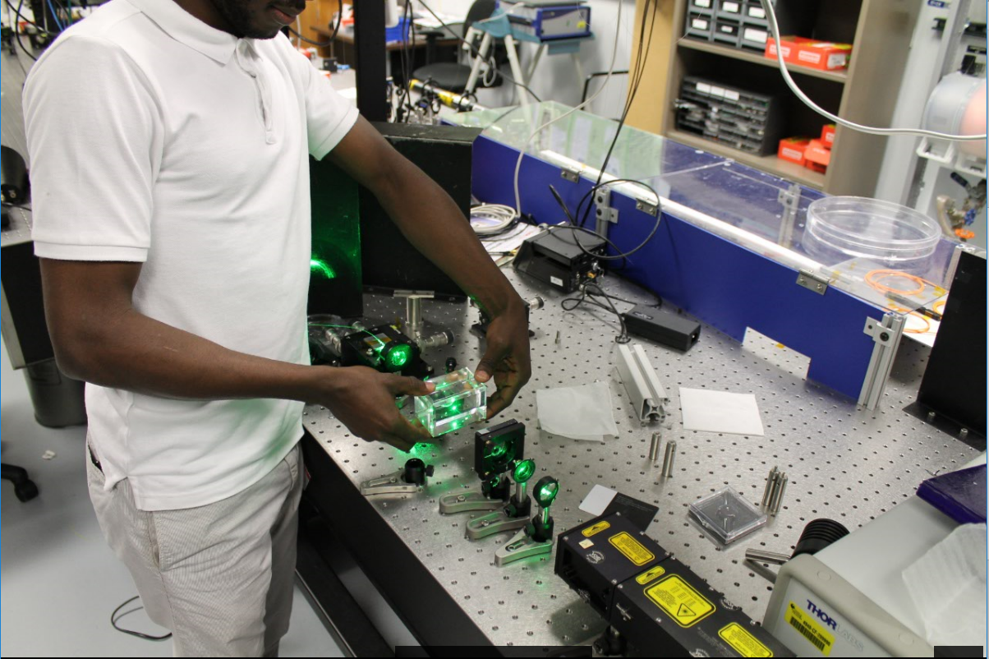
Testing Laser:
With the currently working laser, a system was set in place to damage the glass.
The concept was a proof of our laser is suitable for our project success.

Slide 36
Image Resolution:
Our Image to etch is the UCF Pegasus Logo:
Dimension:
1 inch x 1 inch x 1 inch
Giving a resolution of :
167 x 167 x 167 pixels
With a beam spot size of 3 um.

Slide 37
Overall System Diagram
Power
Movement Mechanisms and Payload
Comms and Control
Optics
Main Supply
U.S. Standard
(110-120 VAC)
AC/DC Adaptor
(12 VDC)
Regulator
(5VDC)
ATmega 328P MCU
Axis Limit Switches
Optics
Motor Driver Supply
(18 - 80 VDC)
Stepper Motor Drivers
FT232RL
USB-to-Serial
Laser
Stepper Motors
Optical Assembly
Z-Axis Mount
X and Y Surface Mount
Etching Glass
Notes:
High level block diagram that provides overview of how subsystems are interacting

Slide 38
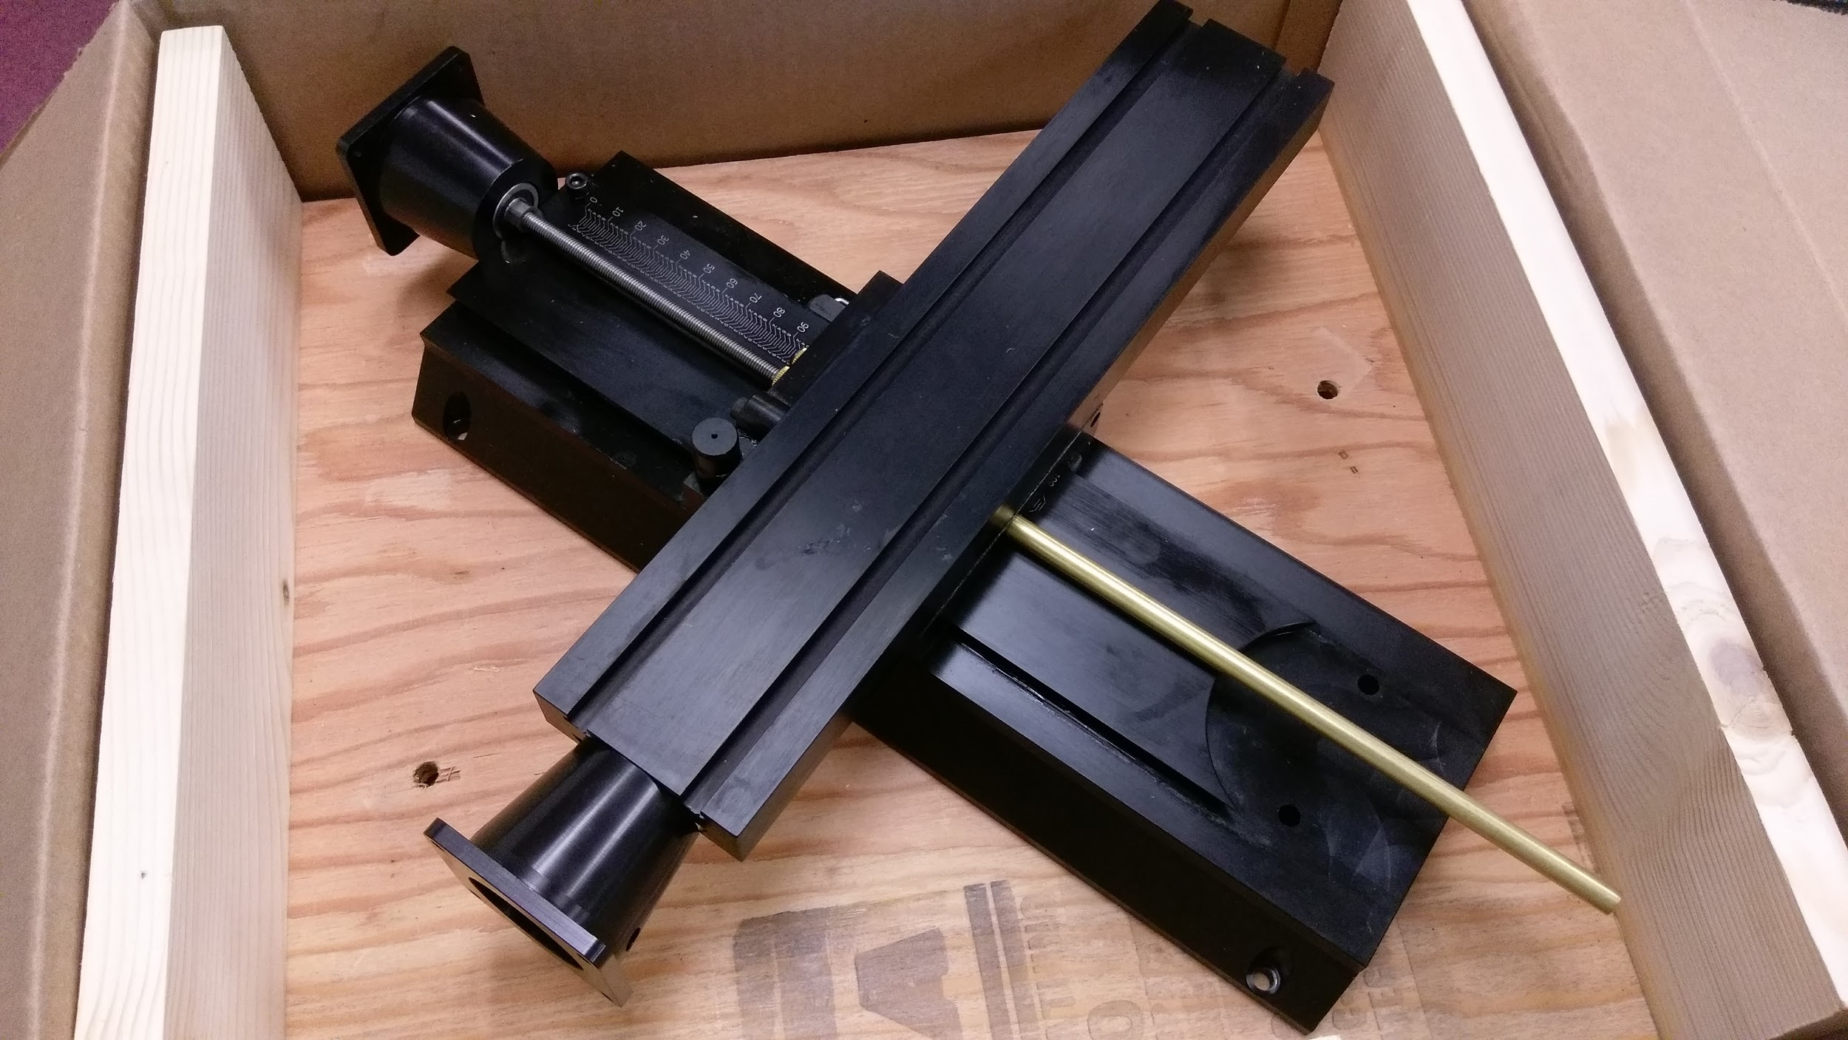
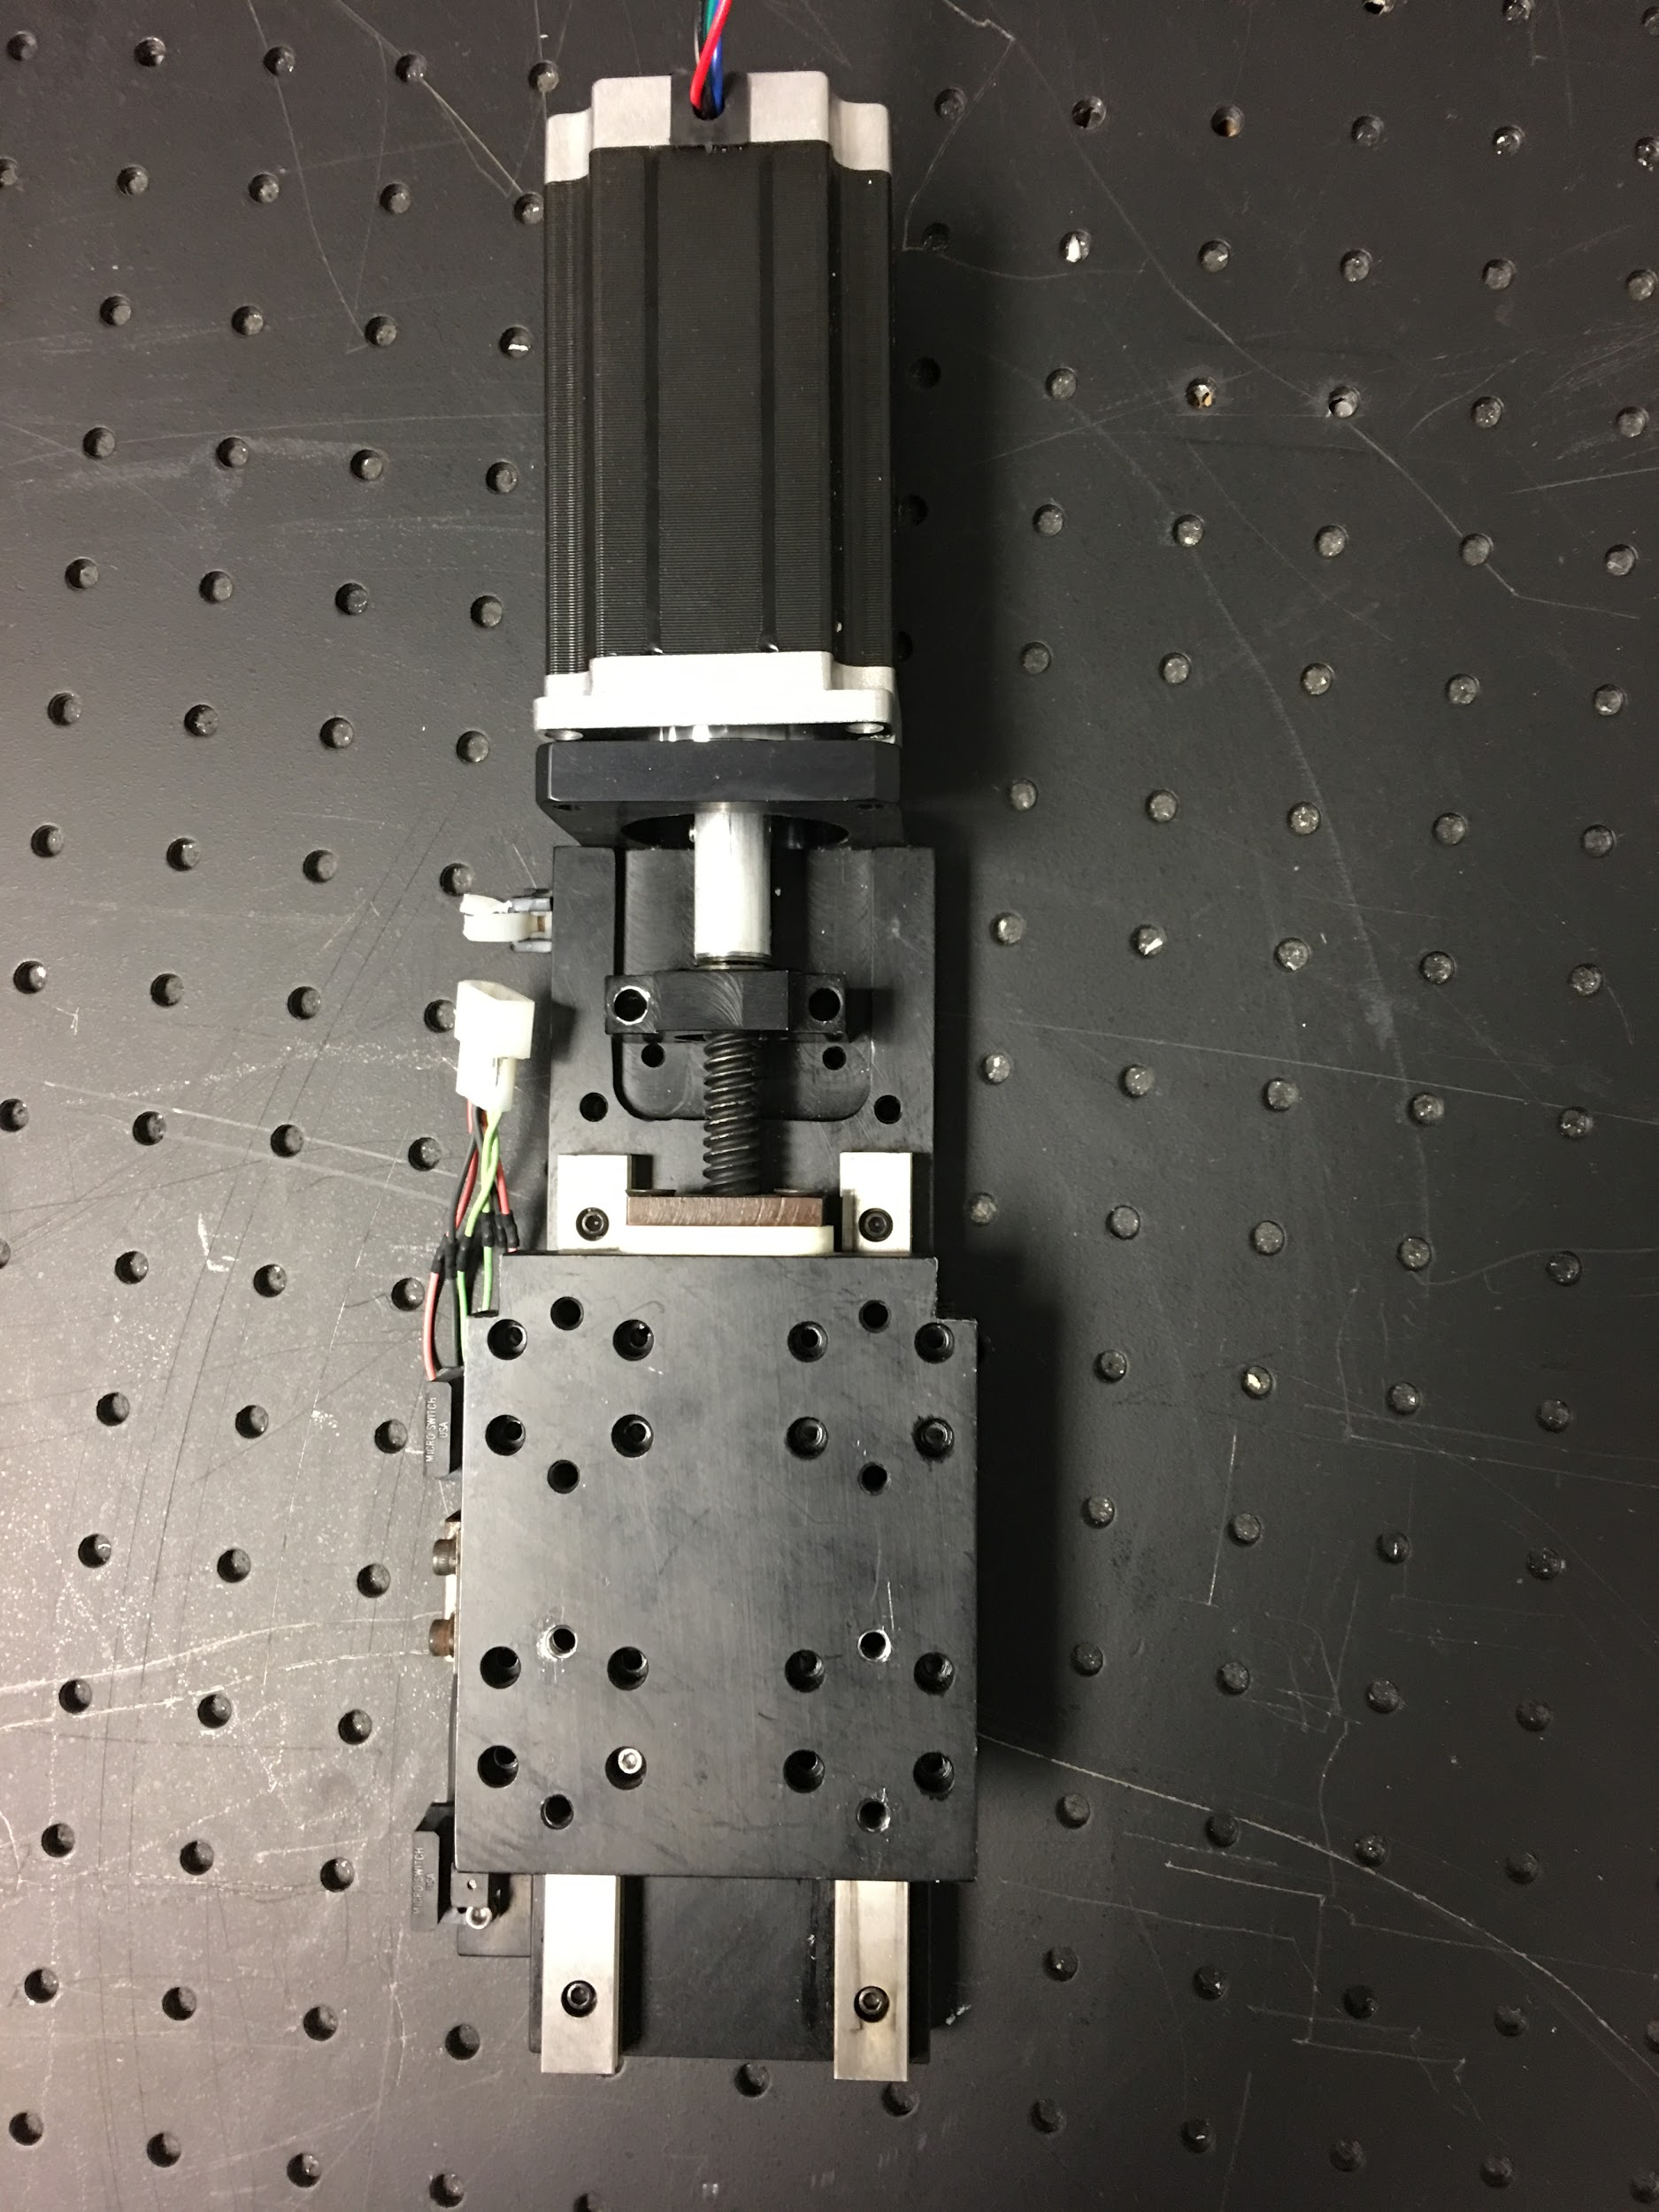
XY-Axis Post & Z-Axis Post:
XY-Linear Stage: Holding the glass to be etched
Z- Stage: Holding Focusing Lens

Slide 39
Administrative Content

Slide 40
Responsibilities
Tasks/Names | Monushka Sicar | Phillip Lane | Nicolas Ramirez | Burdley Colas
Power | First | Second
Movement Mechanisms and Payload | Third | First | Third | Second
Commands and Control | Third | Second | First | Third
Optics |  |  |  | First
Notes:
Work Distribution :

Slide 41
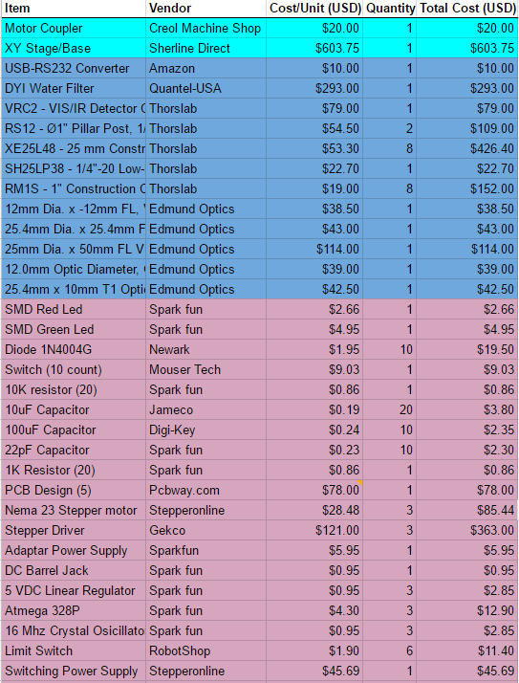
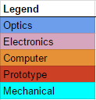
Project Budget
Notes:
Monushka : Burdley & Nick, can you insert your last purchase on the Overall project budget
All: Once burdley & nick insert theirs , I will add it to this slide

Slide 42
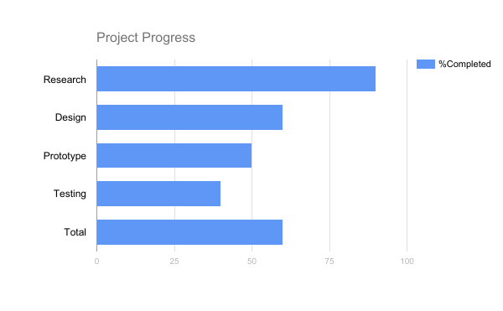
Project Progress
Notes:
If you disagree.. Type below what you think in a different color, and we will discuss together *
Research = 90 %
Design = 60 %
Testing = 40 %
Prototype = 50 %
Total = 5 %

Slide 43
Next Steps
Software Development
Complete user interface
Configure grbl firmware for etching
Hardware Development
PCB soldering
Wiring: PCB to drivers and switches
Framework & Optics Development
XY stage
Mount motors and etching glass to stage
Mount stage to optics table
Z-axis
Mount focusing lenses
Mount vertical post to optics table

Slide 44
Success / Issues
Electrical Engineer
S: Components have been successfully working
I: Designing of the PCB
I: Status of orders
Computer Engineer
S: Sufficient Progress in GUI
I: Incomplete testing of slicing/G-code
I: Incomplete testing of RS232 laser control
Optics and Photonics Science and Engineering
I: Laser functionality
S: Etching into glass
Notes:
S: Is for success
I: Is for issues

Slide 45
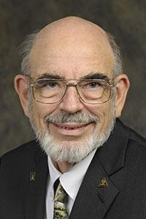
Thanking
Our Sponsor Dr. MJ Soileau

Slide 46
Questions?

